Slide 1
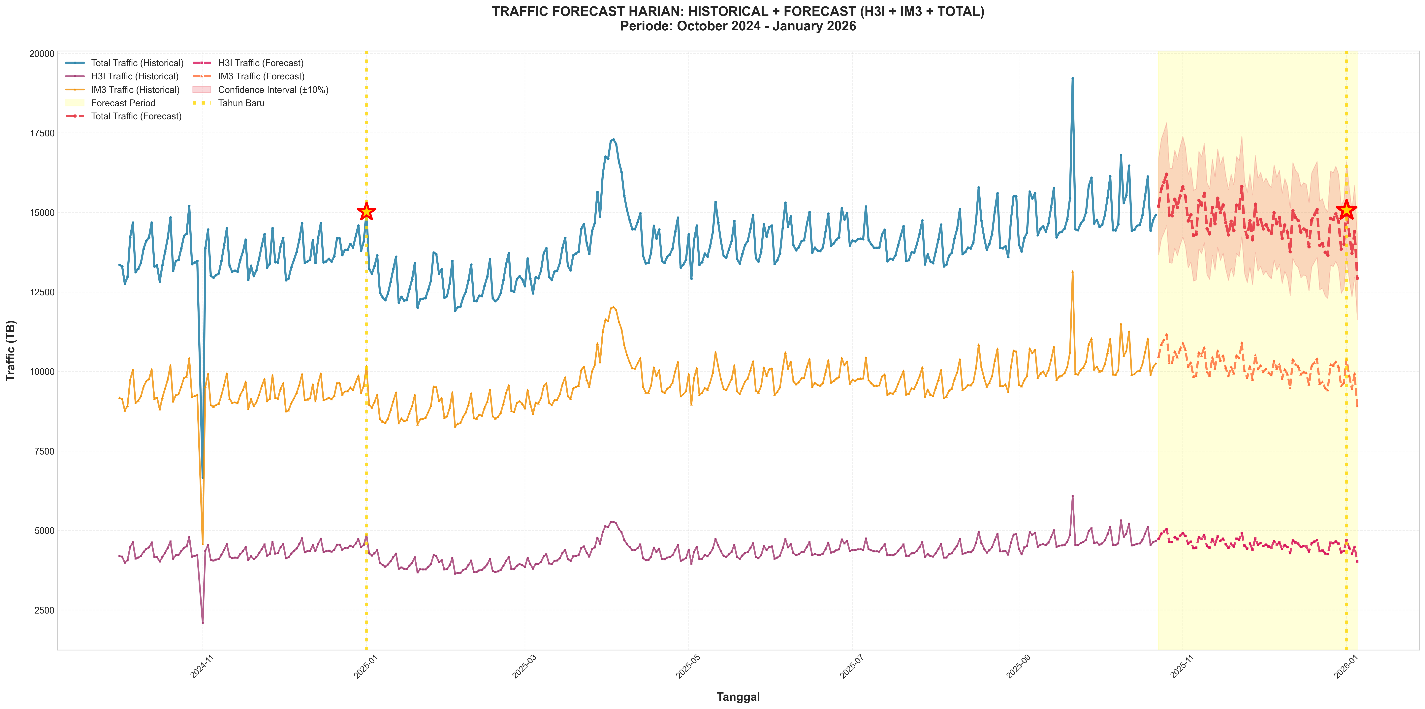
Traffic Forecast Lengkap: Historical + Forecast

Slide 2
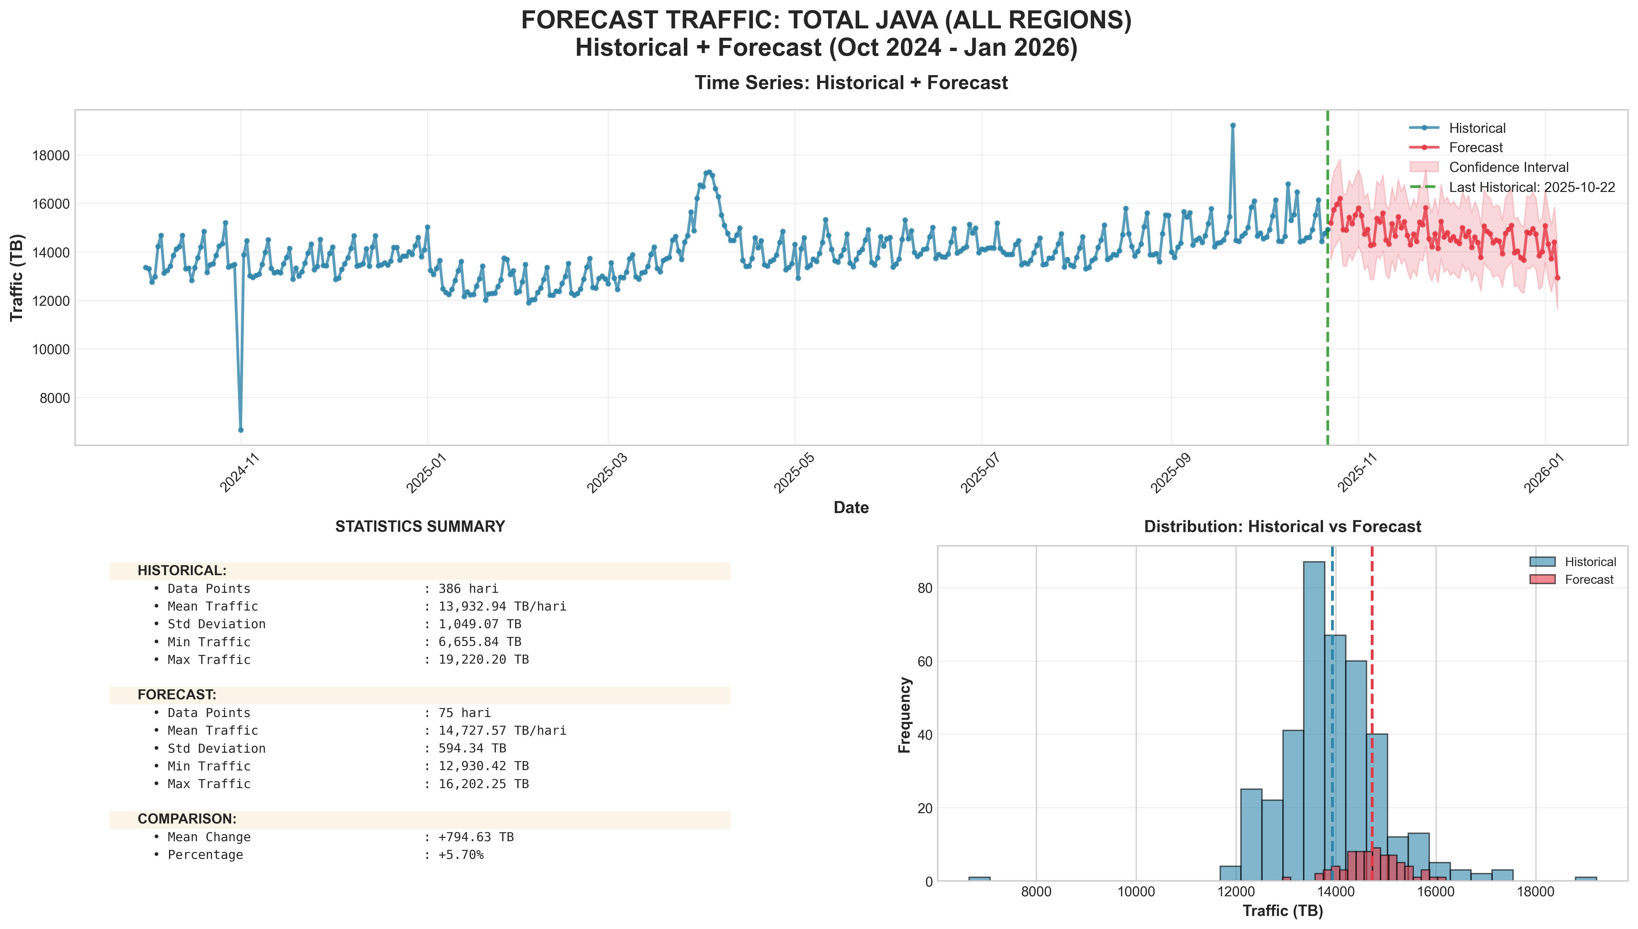
Main Forecast Overview: Total Java

Slide 3
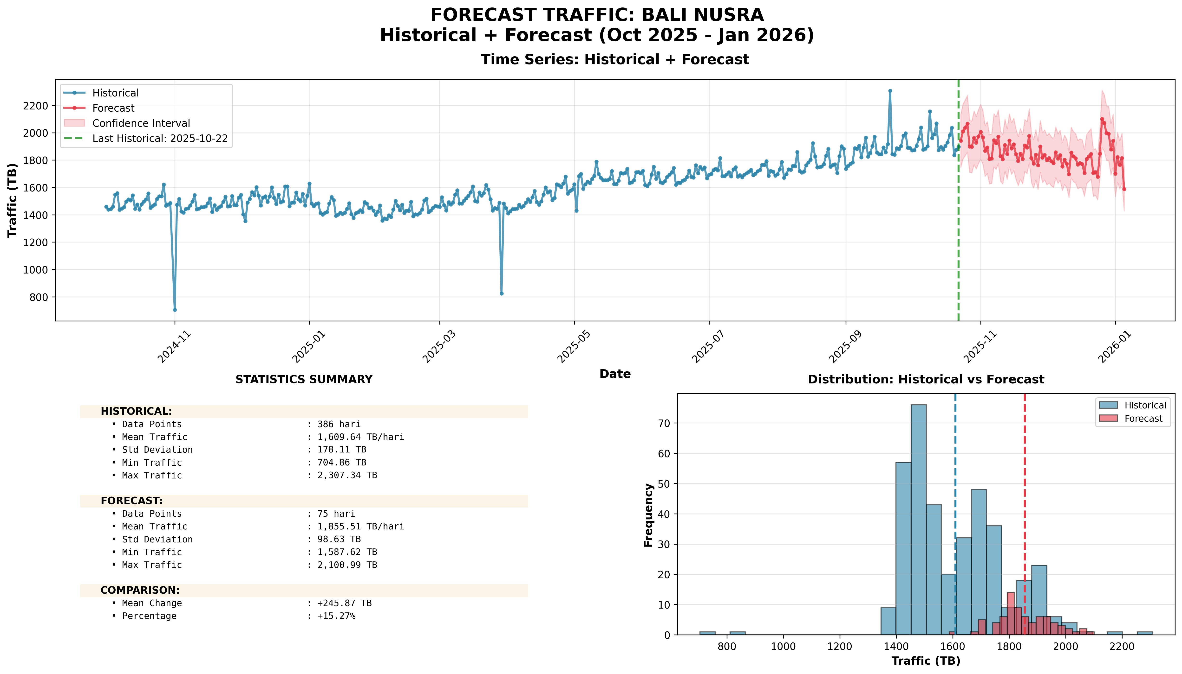
Forecast Regional: Bali Nusra

Slide 4
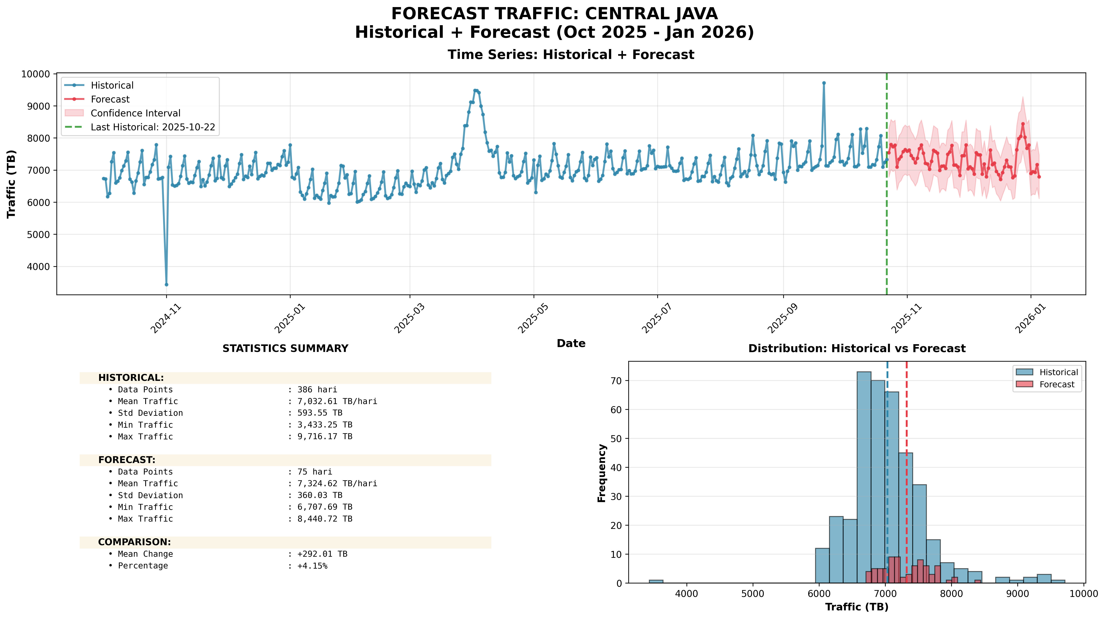
Forecast Regional: Central Java

Slide 5
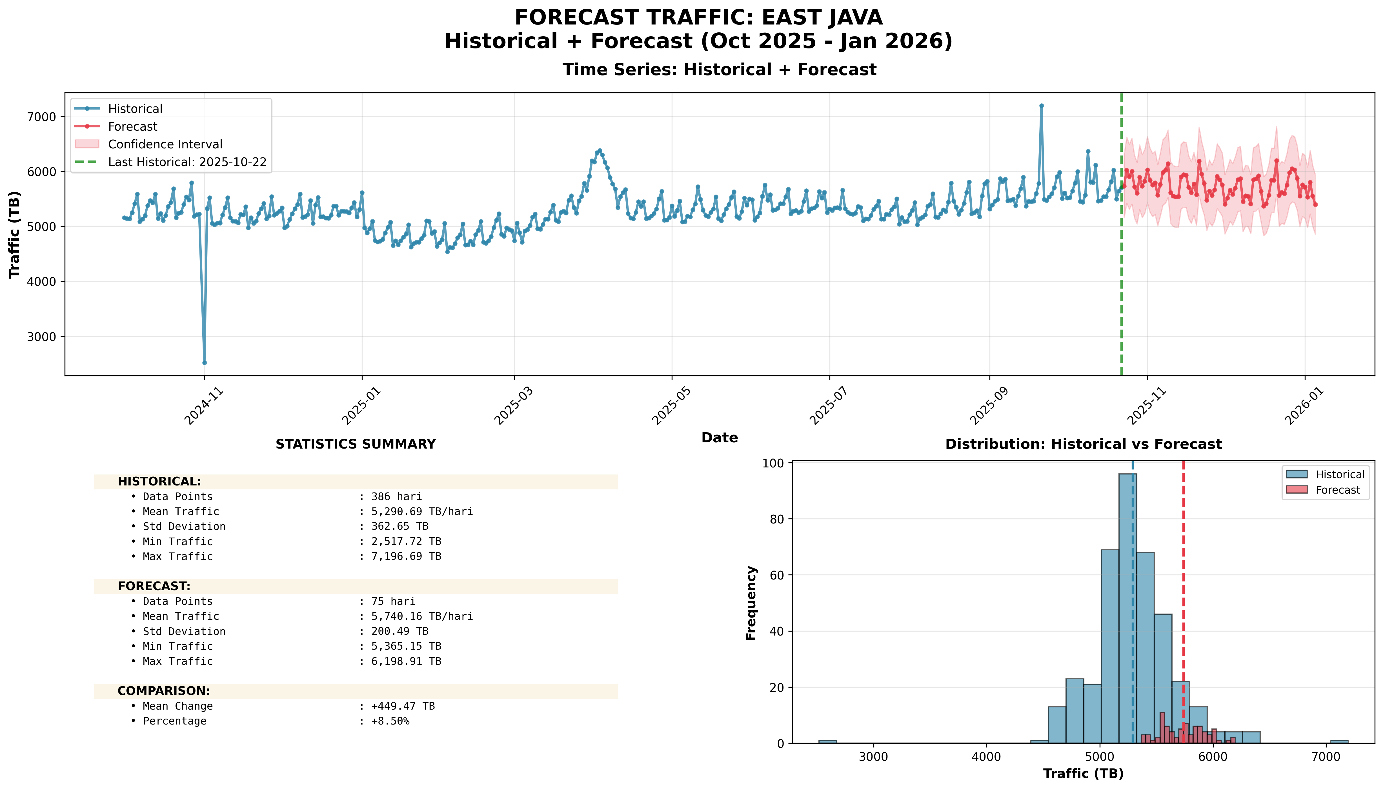
Forecast Regional: East Java

Slide 6
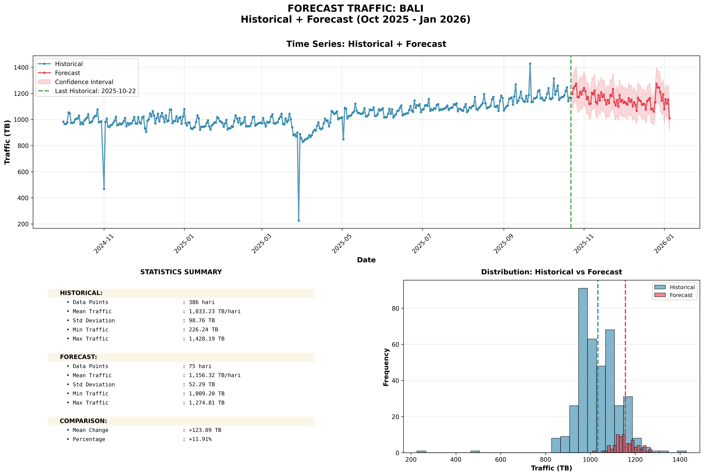
Forecast Provinsi: Bali

Slide 7
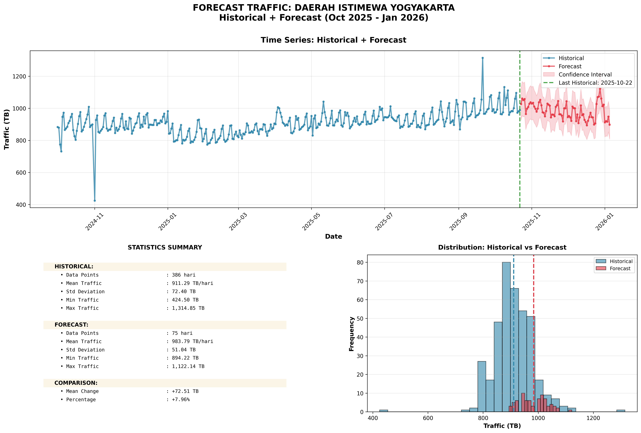
Forecast Provinsi: Daerah Istimewa Yogyakarta

Slide 8
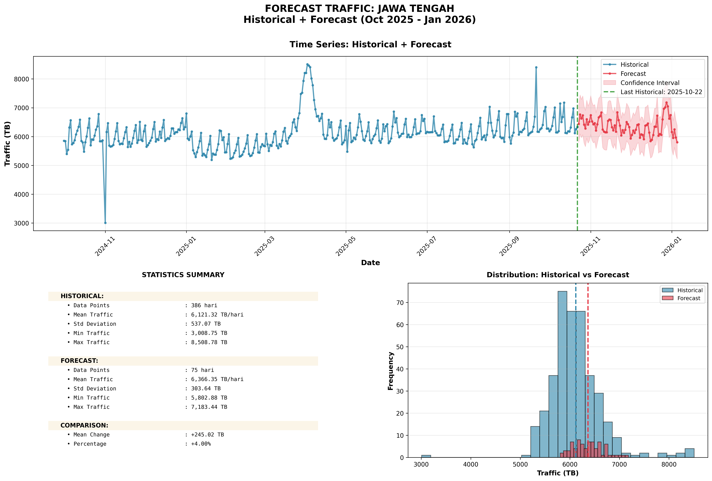
Forecast Provinsi: Jawa Tengah

Slide 9
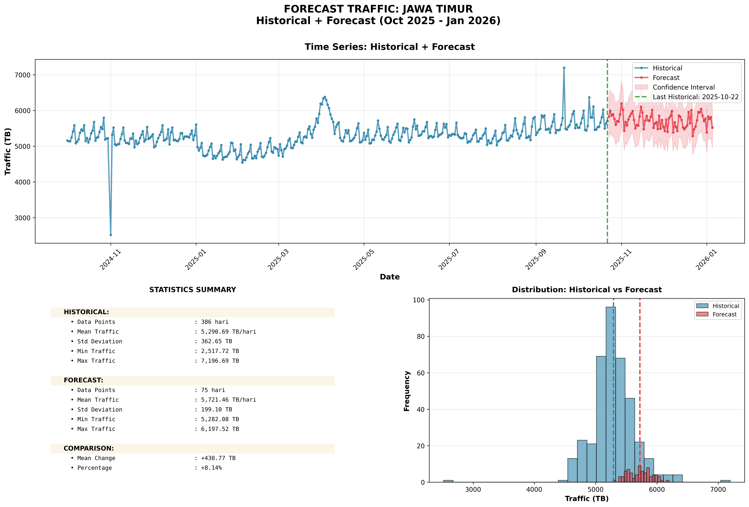
Forecast Provinsi: Jawa Timur

Slide 10
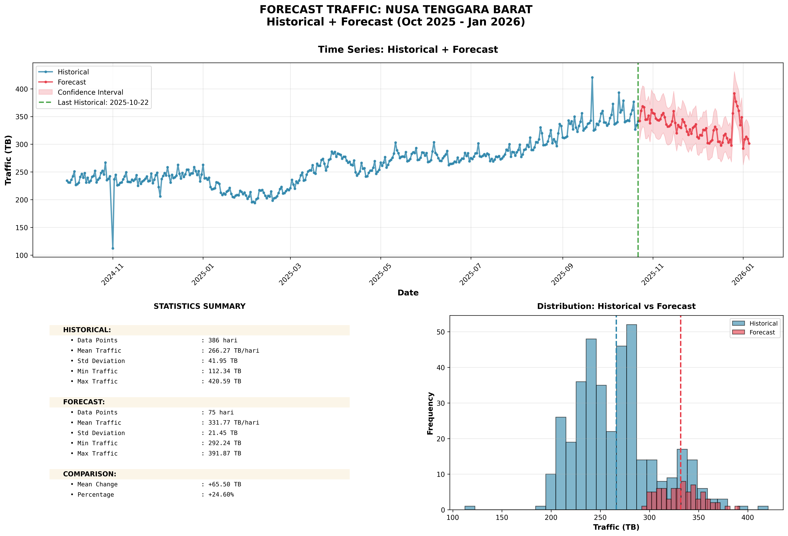
Forecast Provinsi: Nusa Tenggara Barat

Slide 11
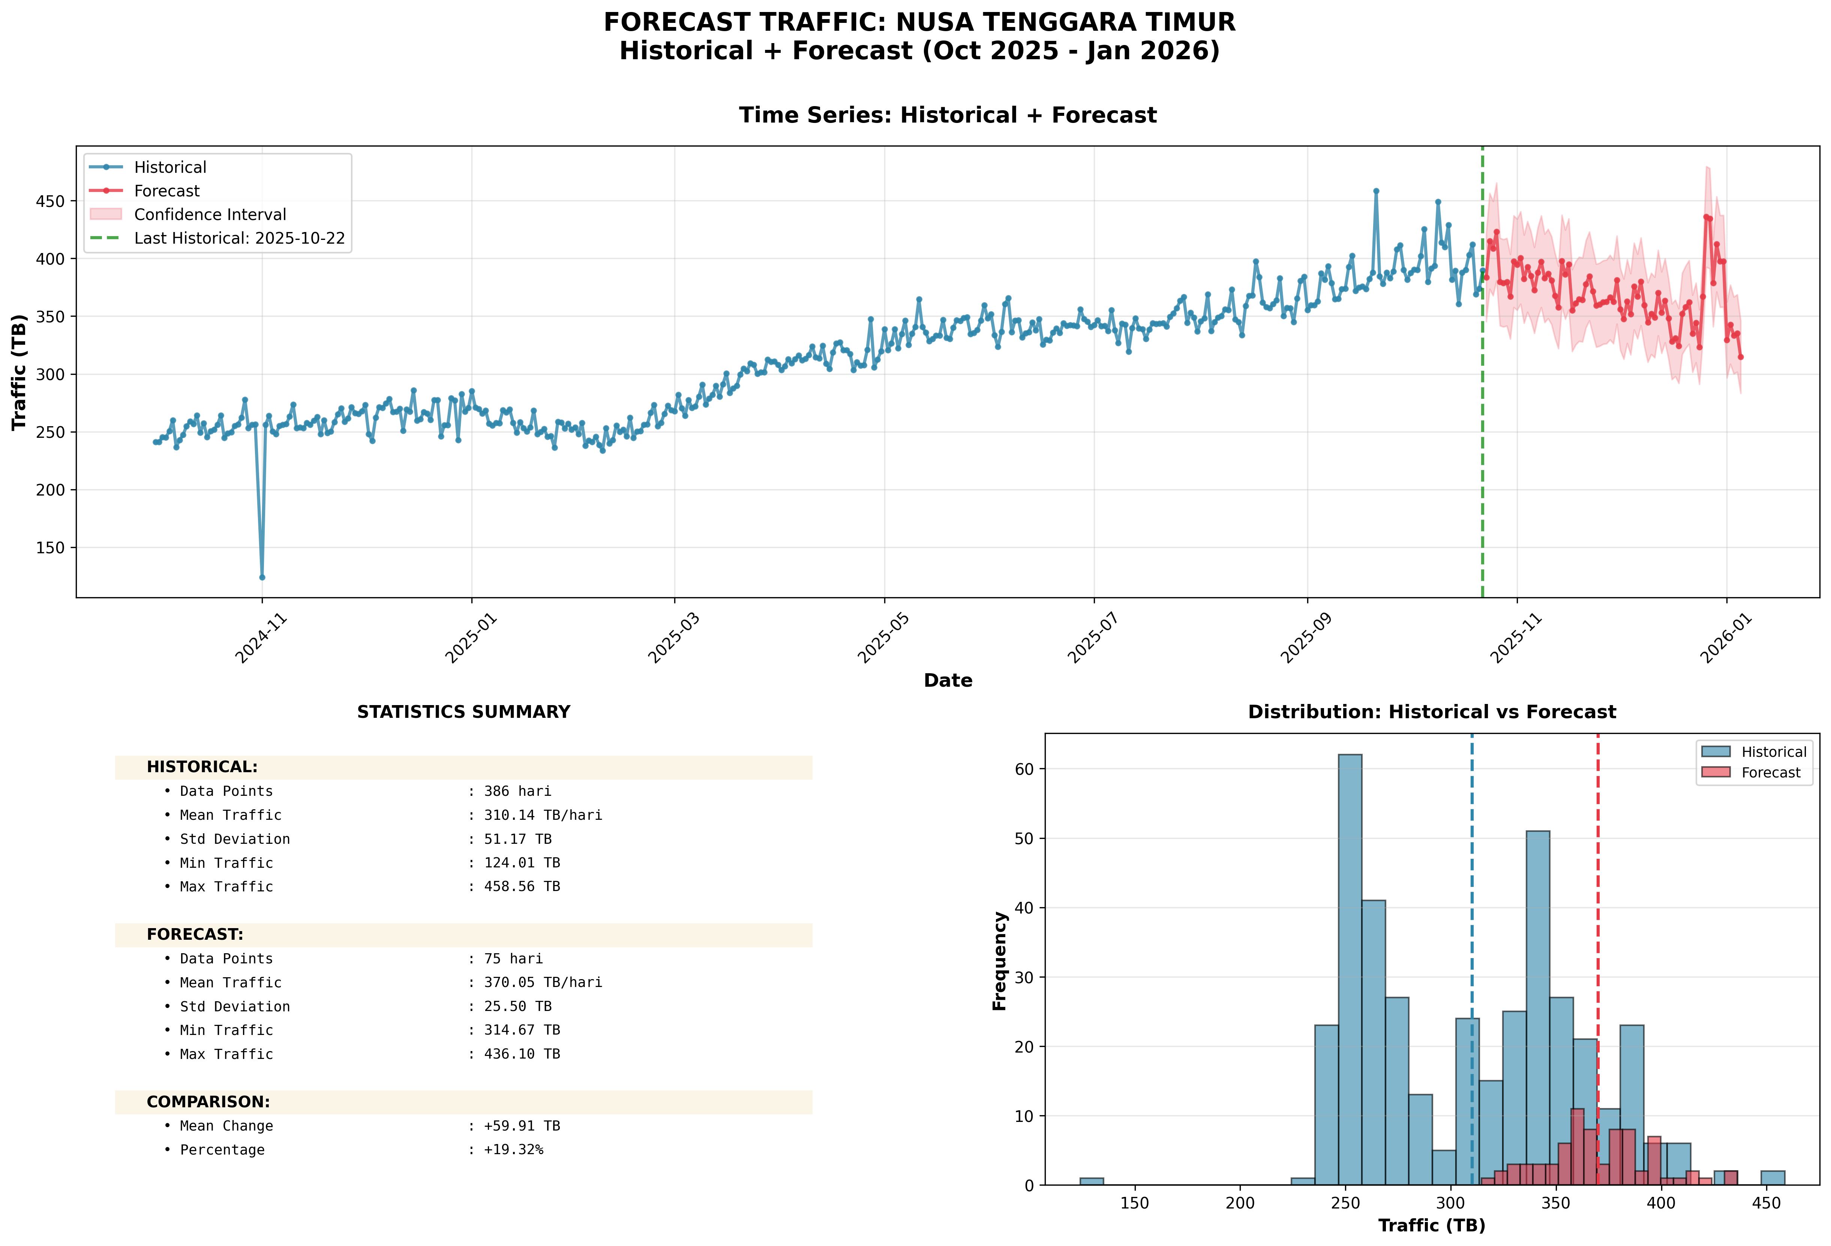
Forecast Provinsi: Nusa Tenggara Timur

Slide 12
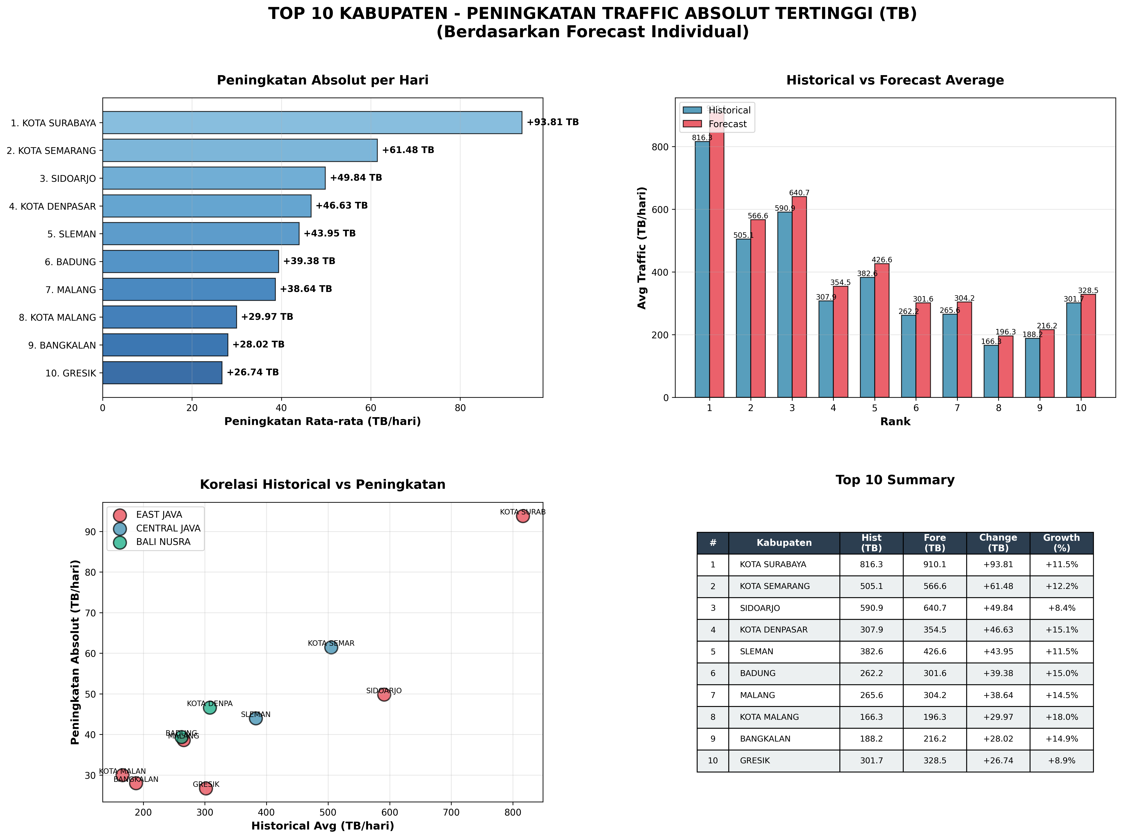
Top 10 Kabupaten: Peningkatan Absolut (TB)

Slide 13
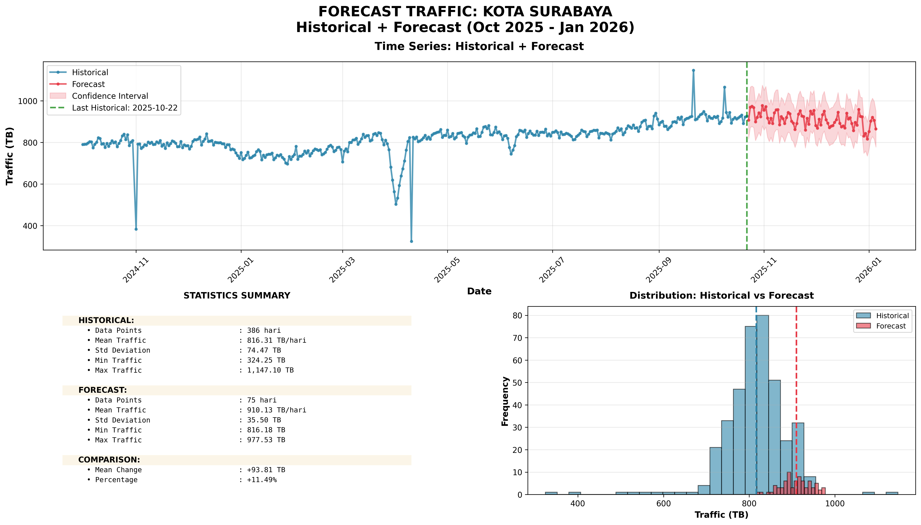
Top 10 Absolute: #1: KOTA SURABAYA (EAST JAVA)

Slide 14
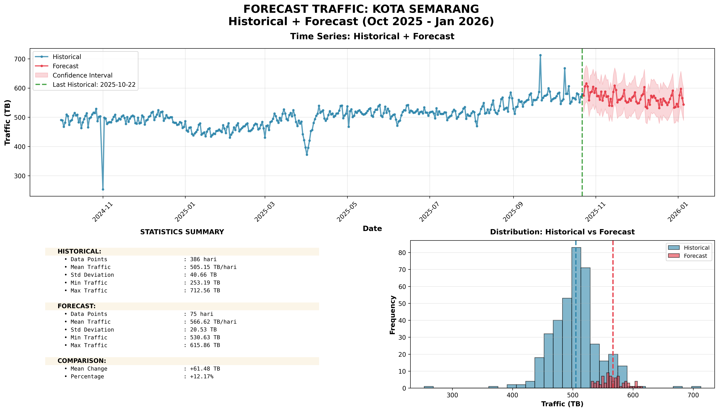
Top 10 Absolute: #2: KOTA SEMARANG (CENTRAL JAVA)

Slide 15
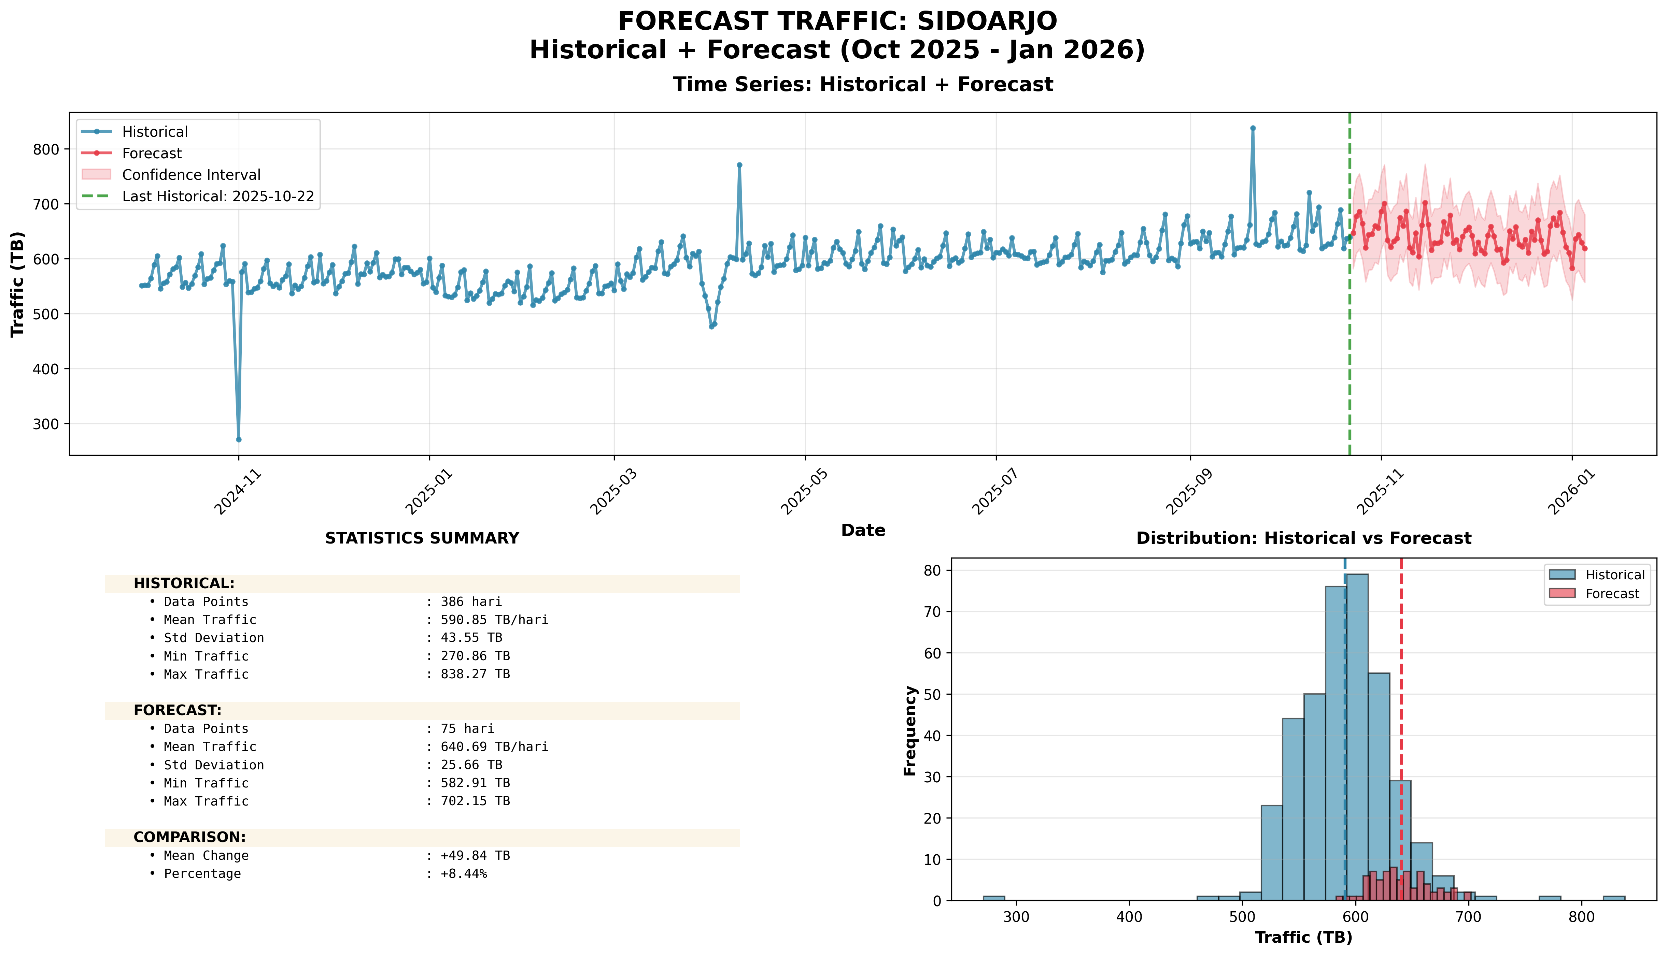
Top 10 Absolute: #3: SIDOARJO (EAST JAVA)

Slide 16
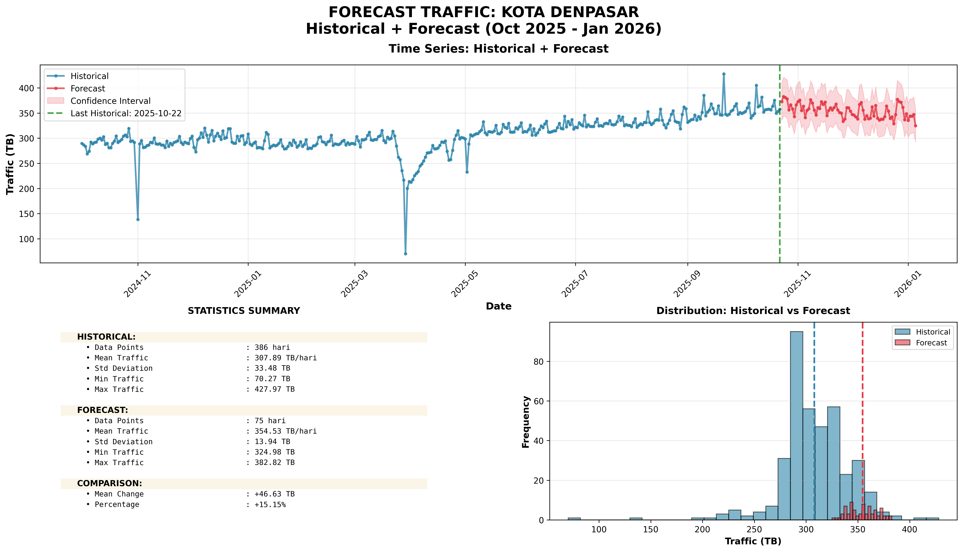
Top 10 Absolute: #4: KOTA DENPASAR (BALI NUSRA)

Slide 17
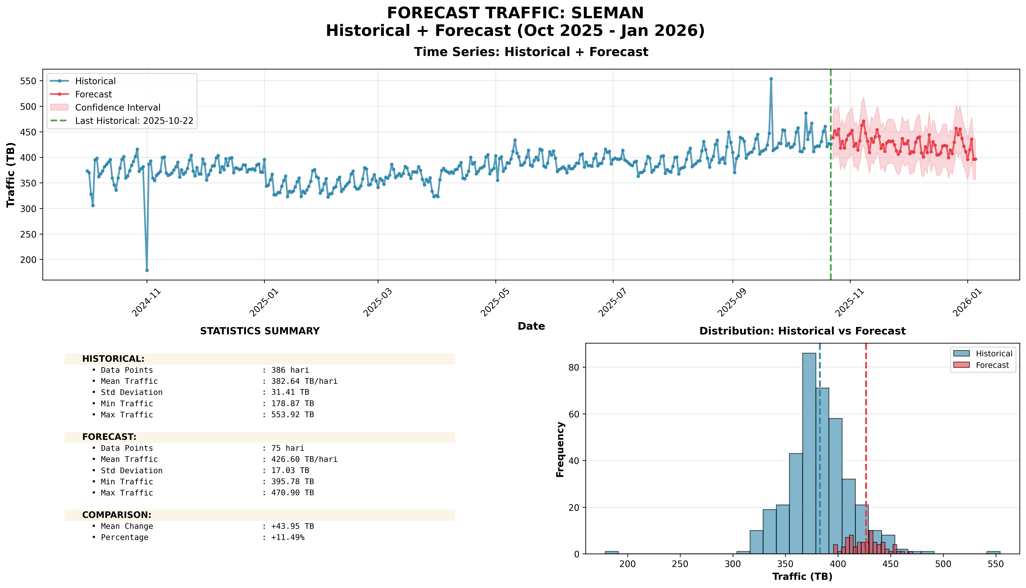
Top 10 Absolute: #5: SLEMAN (CENTRAL JAVA)

Slide 18
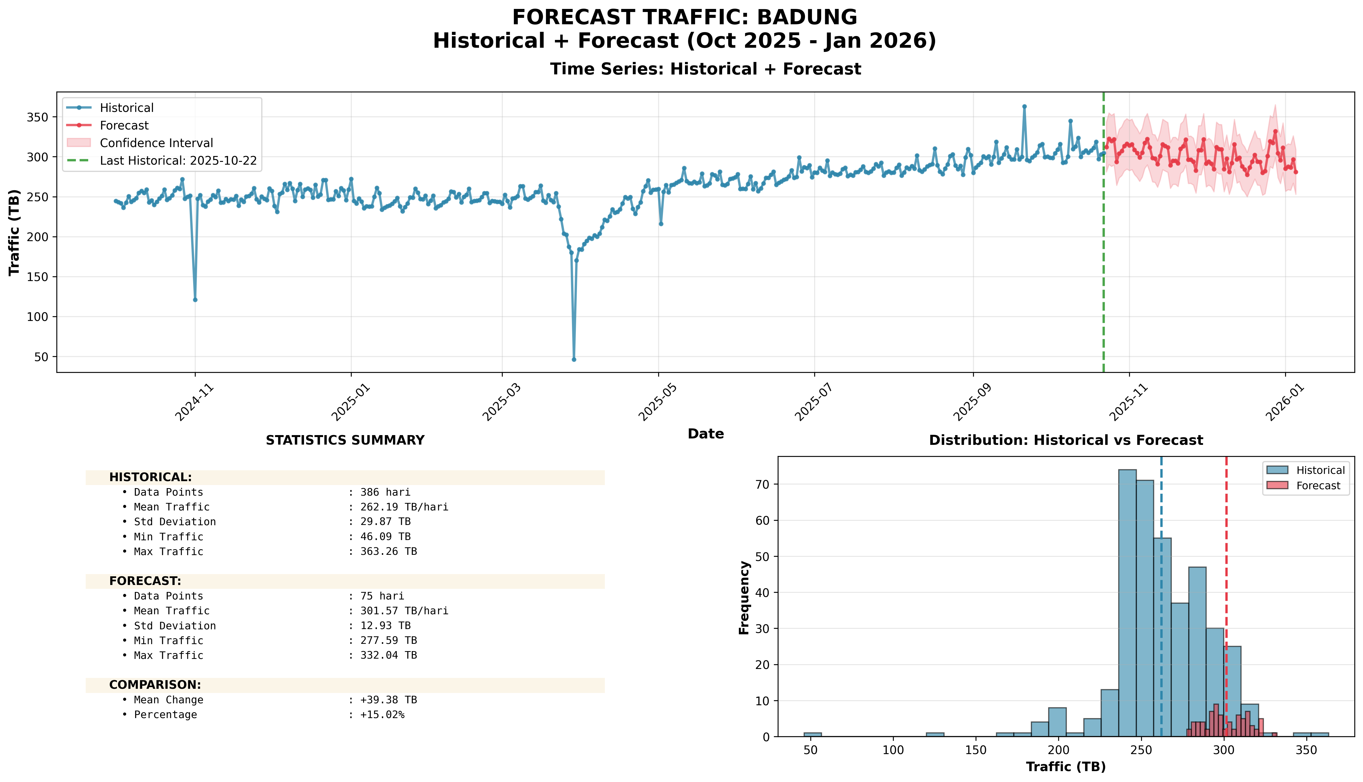
Top 10 Absolute: #6: BADUNG (BALI NUSRA)

Slide 19
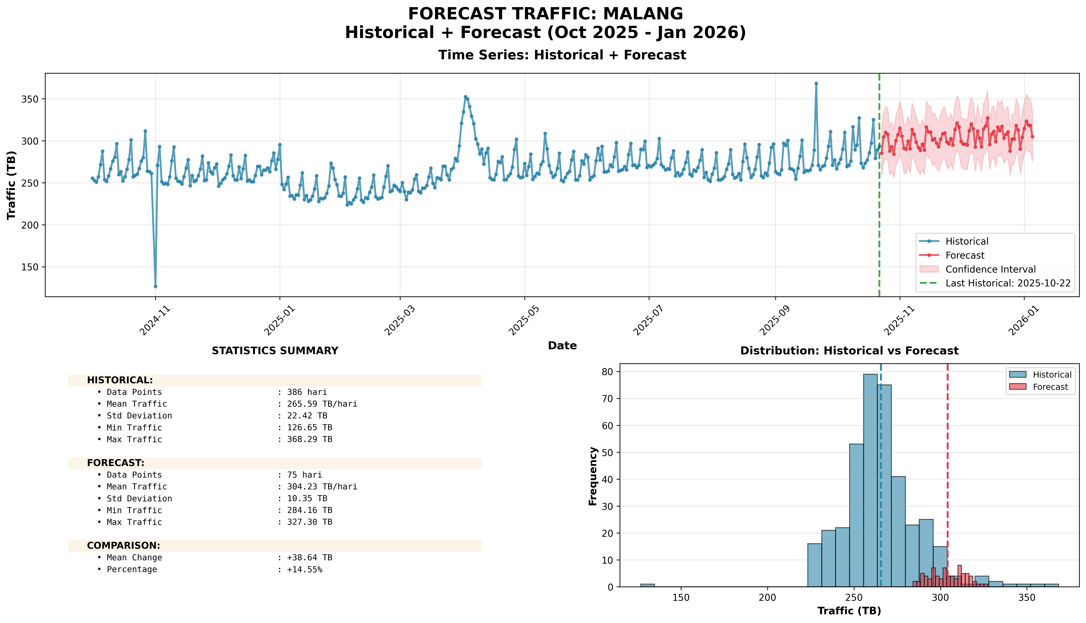
Top 10 Absolute: #7: MALANG (EAST JAVA)

Slide 20
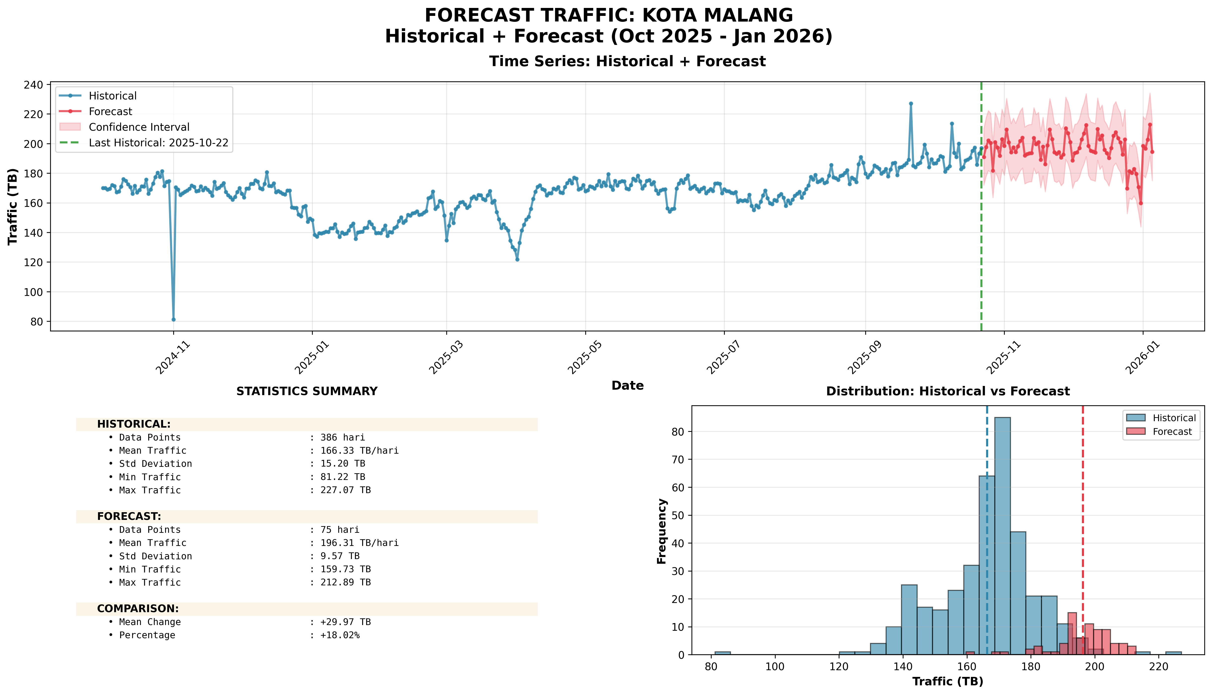
Top 10 Absolute: #8: KOTA MALANG (EAST JAVA)

Slide 21
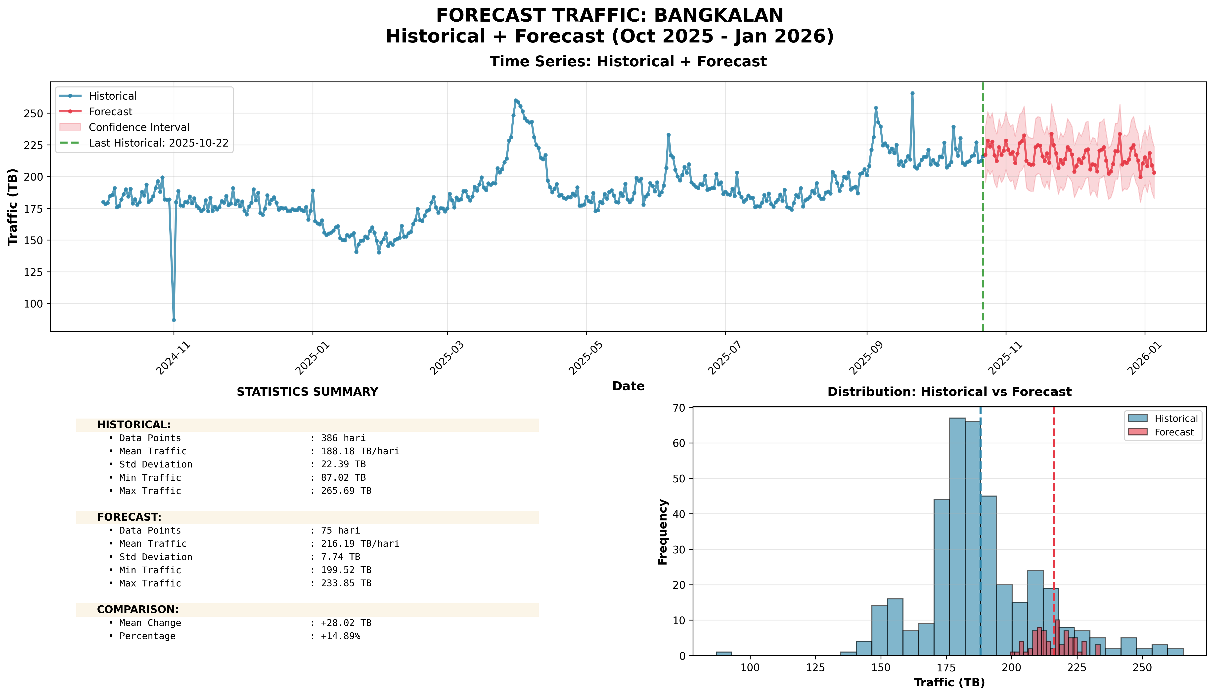
Top 10 Absolute: #9: BANGKALAN (EAST JAVA)

Slide 22
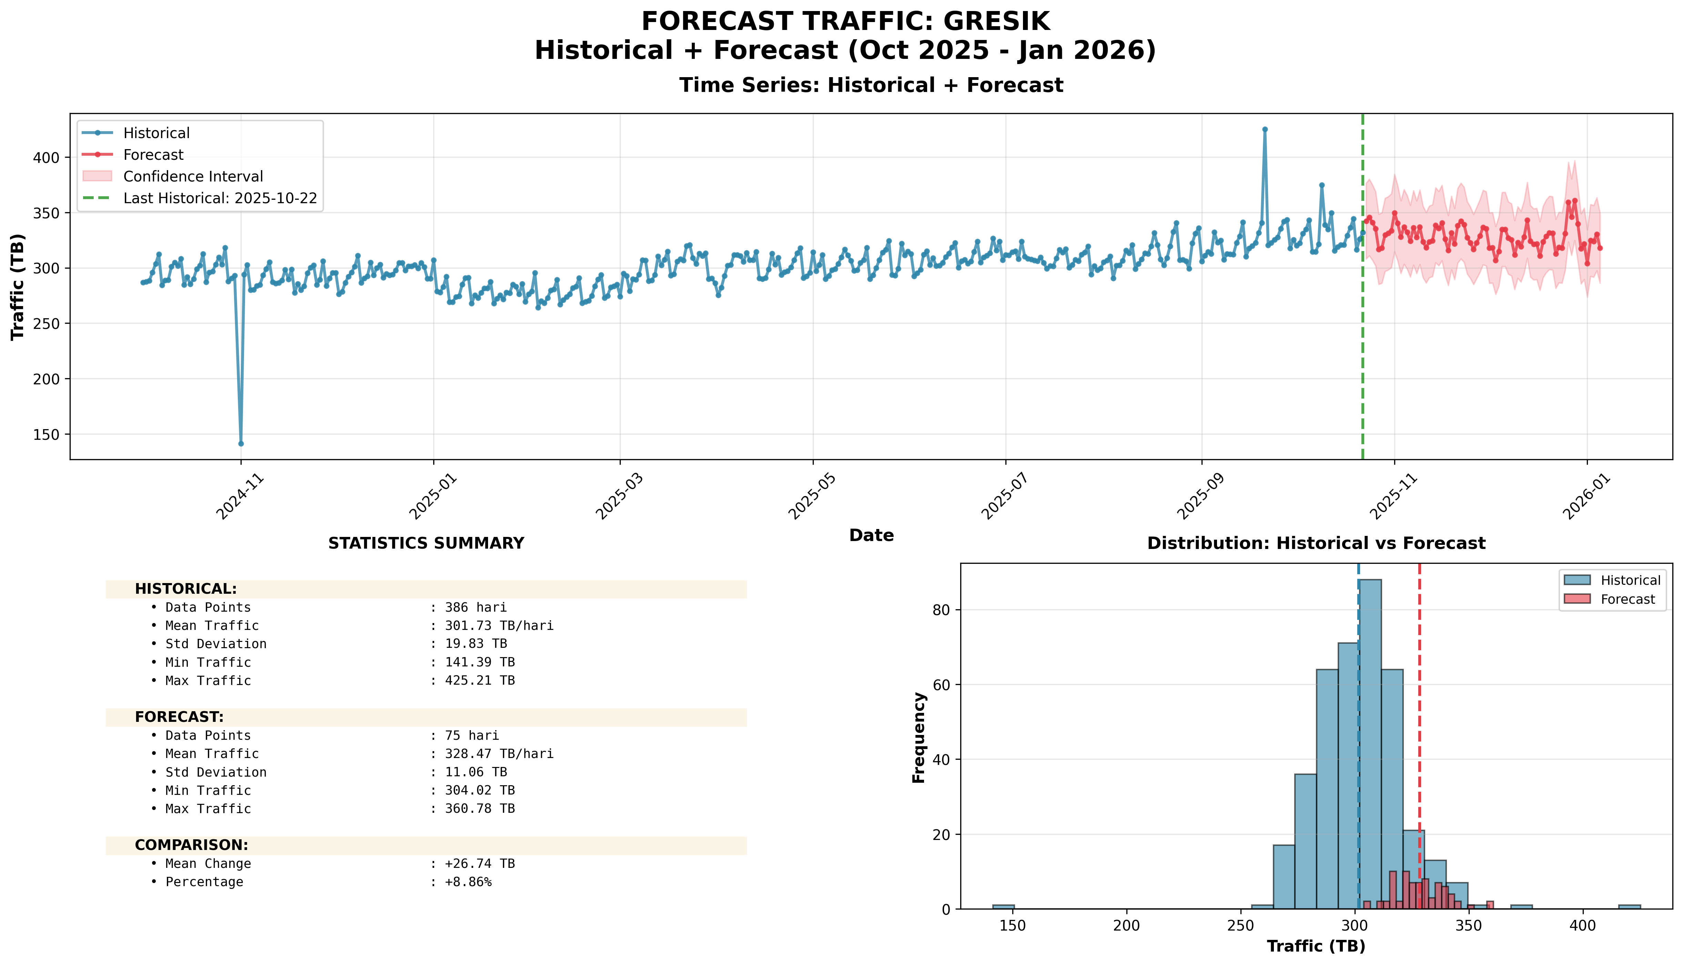
Top 10 Absolute: #10: GRESIK (EAST JAVA)

Slide 23
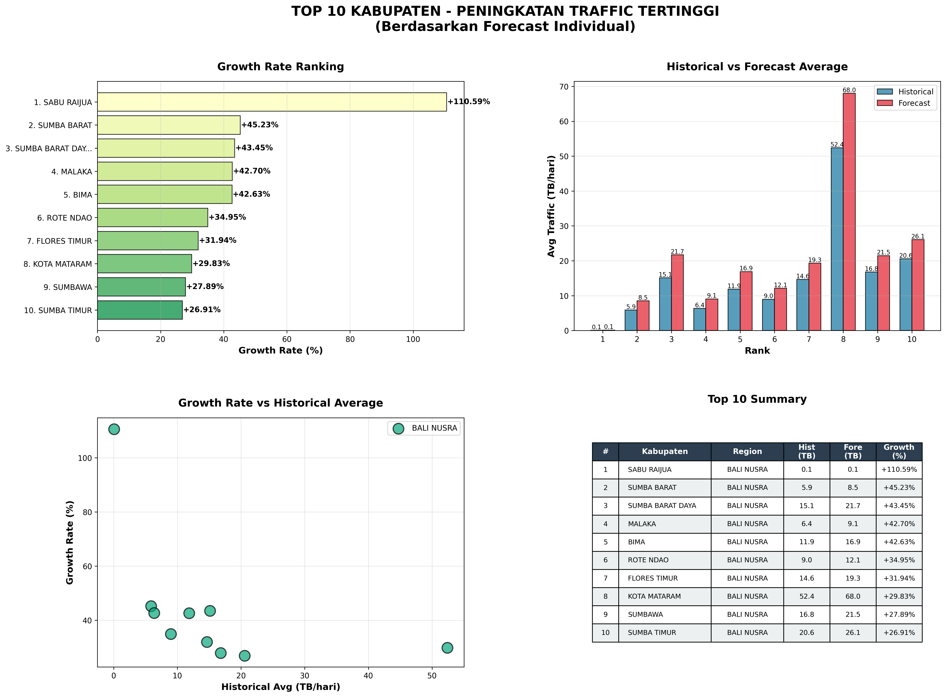
Top 10 Kabupaten: Growth Percentage (%)

Slide 24
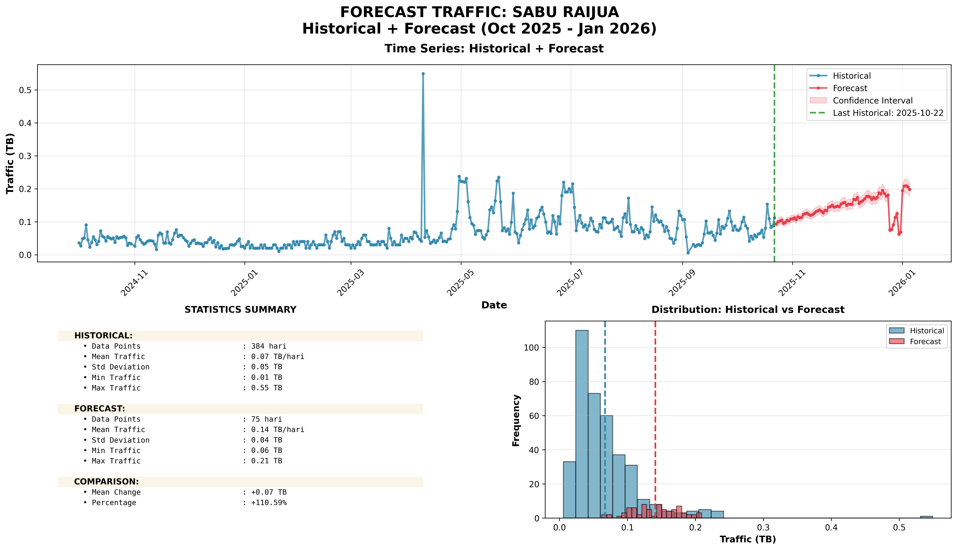
Top 10 Percentage: #1: SABU RAIJUA (+110.59%)

Slide 25
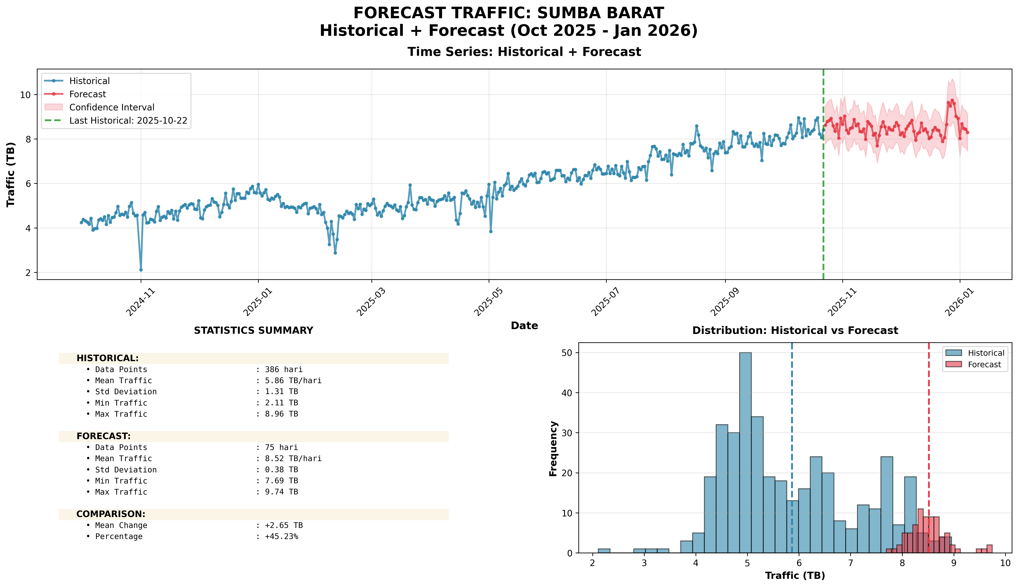
Top 10 Percentage: #2: SUMBA BARAT (+45.23%)

Slide 26
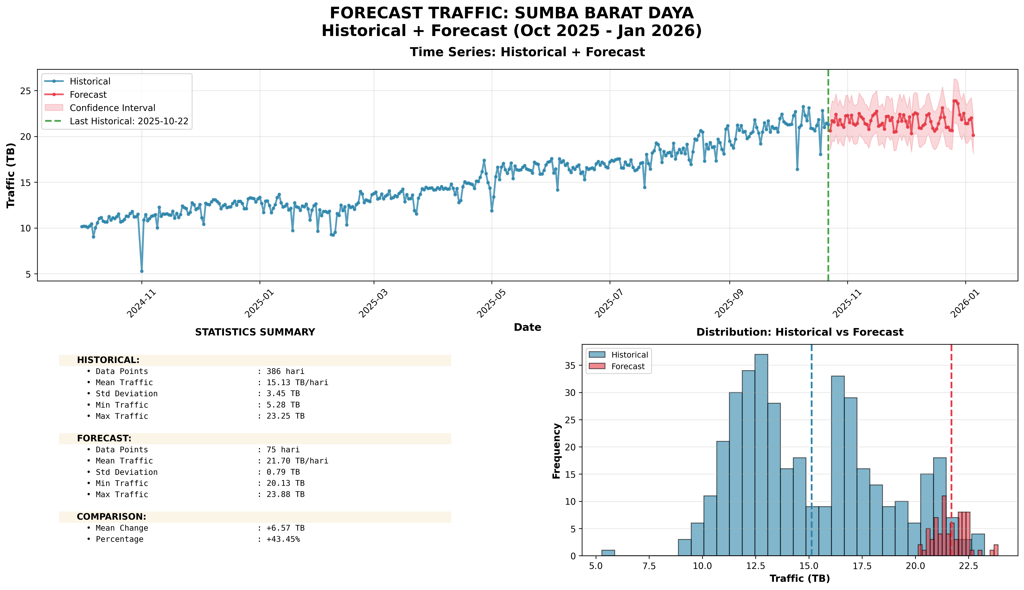
Top 10 Percentage: #3: SUMBA BARAT DAYA (+43.45%)

Slide 27
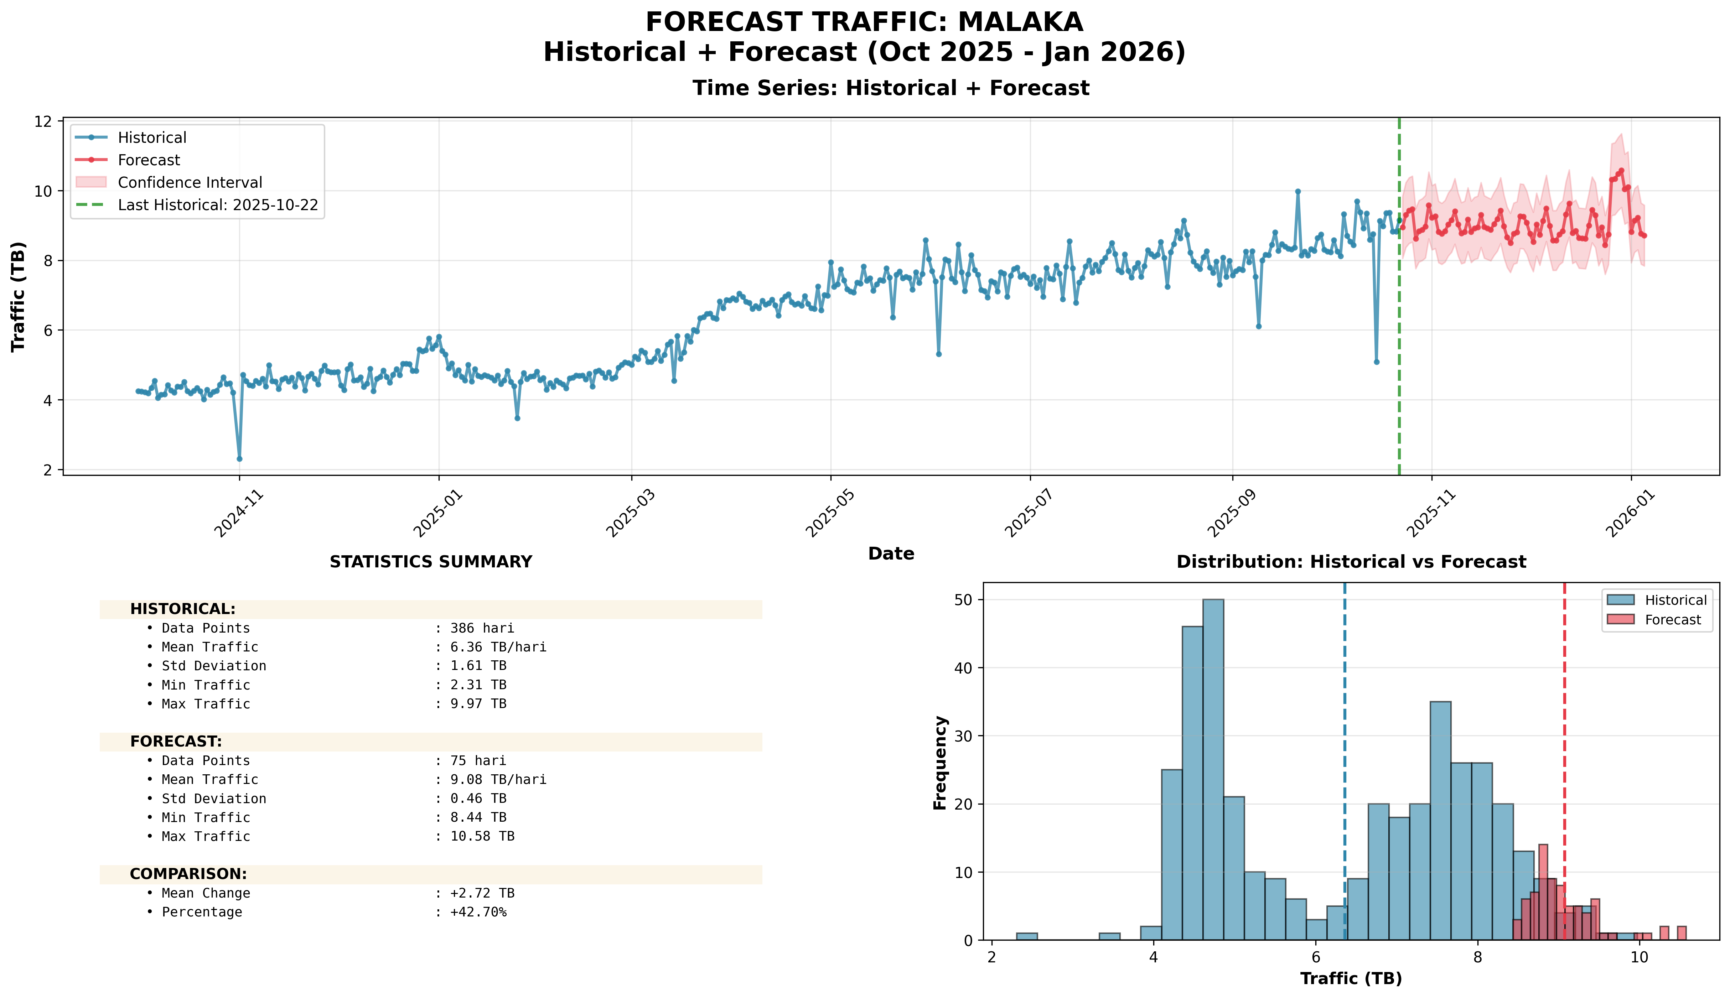
Top 10 Percentage: #4: MALAKA (+42.70%)

Slide 28
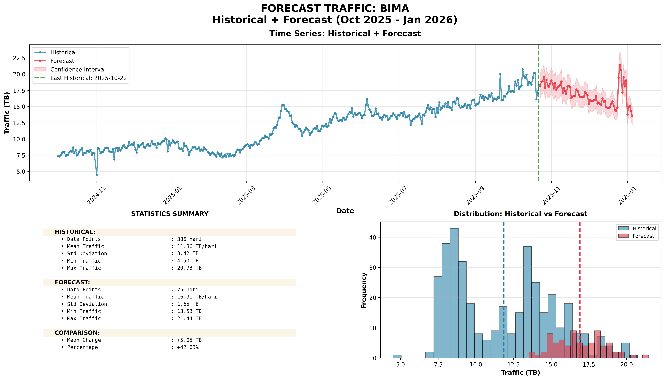
Top 10 Percentage: #5: BIMA (+42.63%)

Slide 29
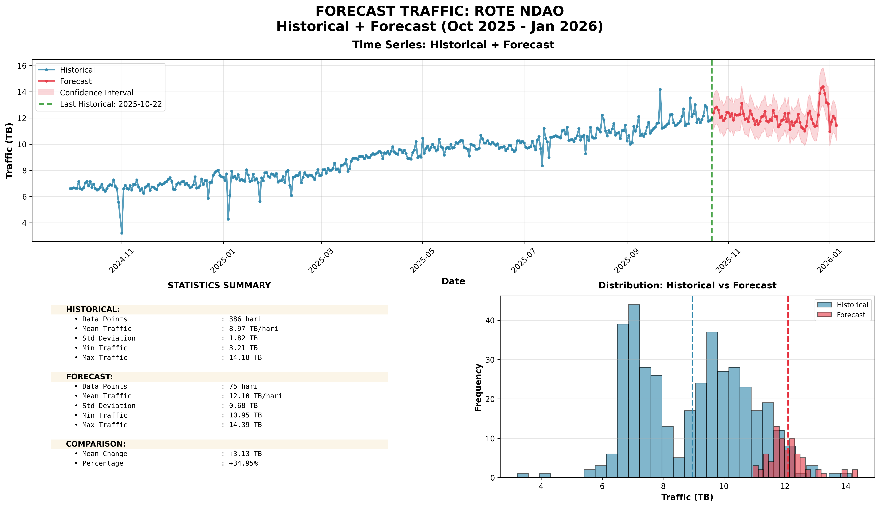
Top 10 Percentage: #6: ROTE NDAO (+34.95%)

Slide 30
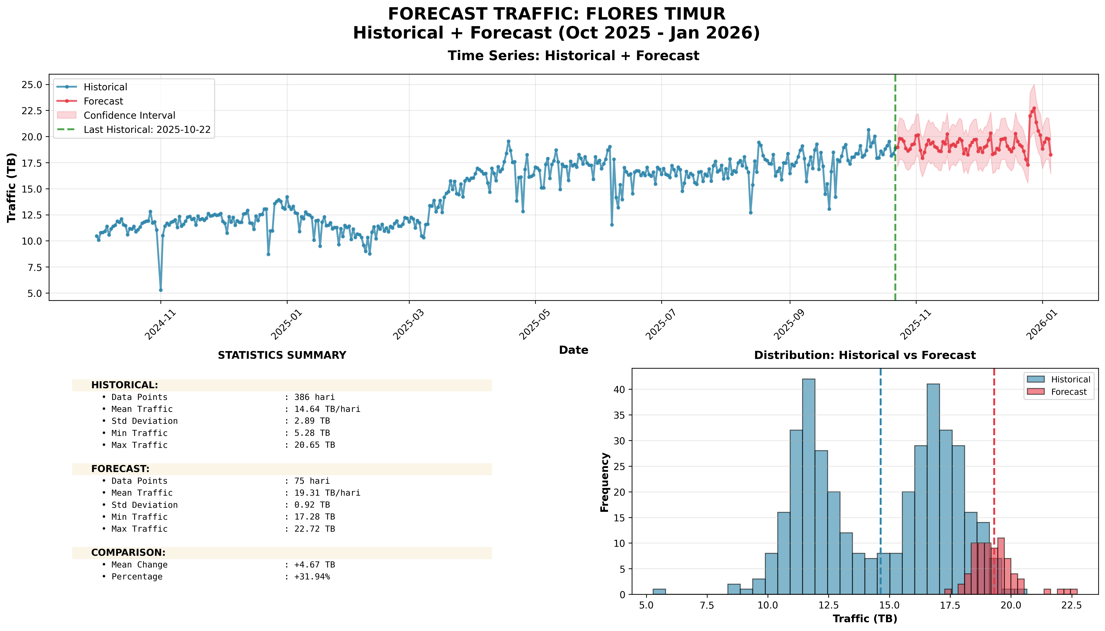
Top 10 Percentage: #7: FLORES TIMUR (+31.94%)

Slide 31
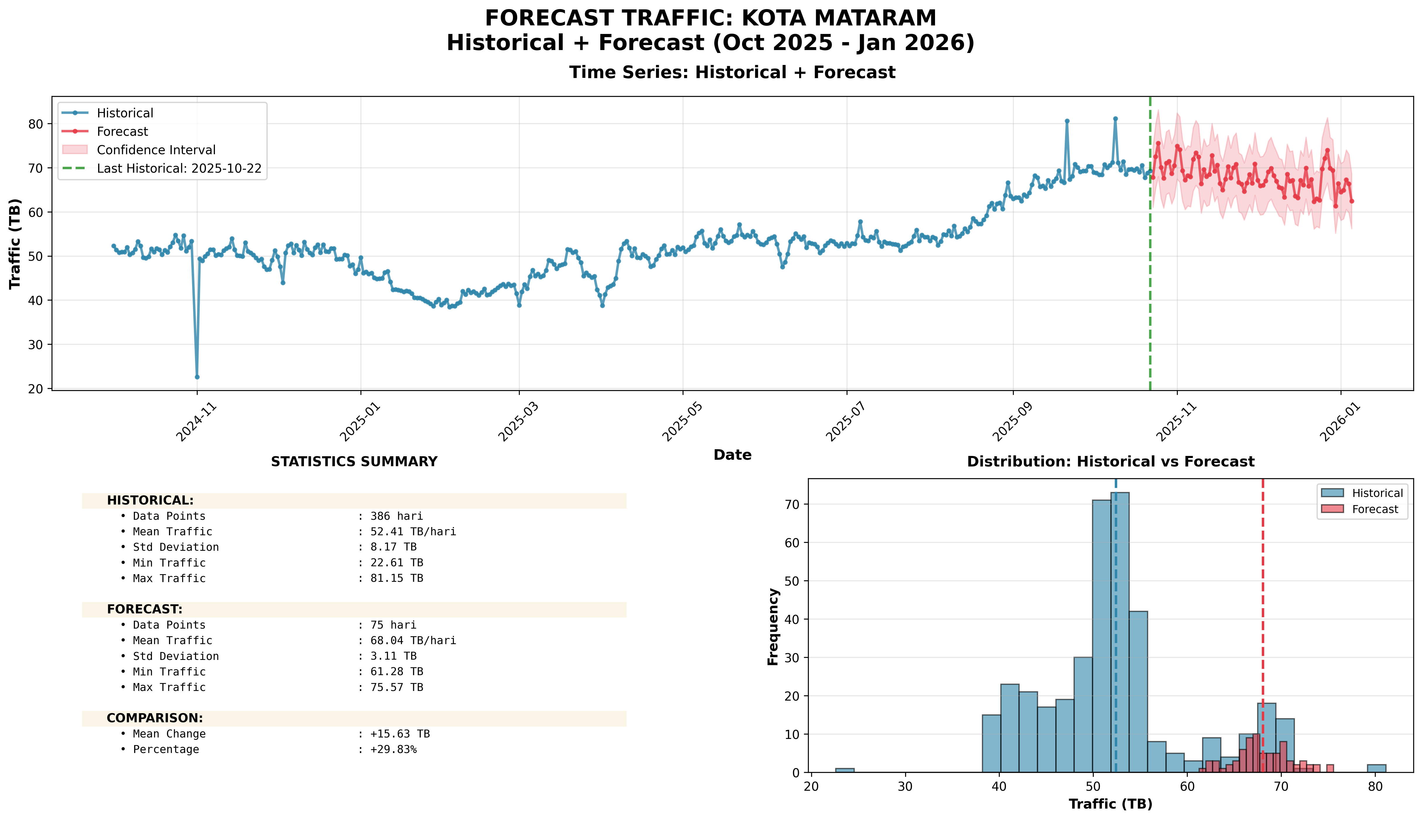
Top 10 Percentage: #8: KOTA MATARAM (+29.83%)

Slide 32
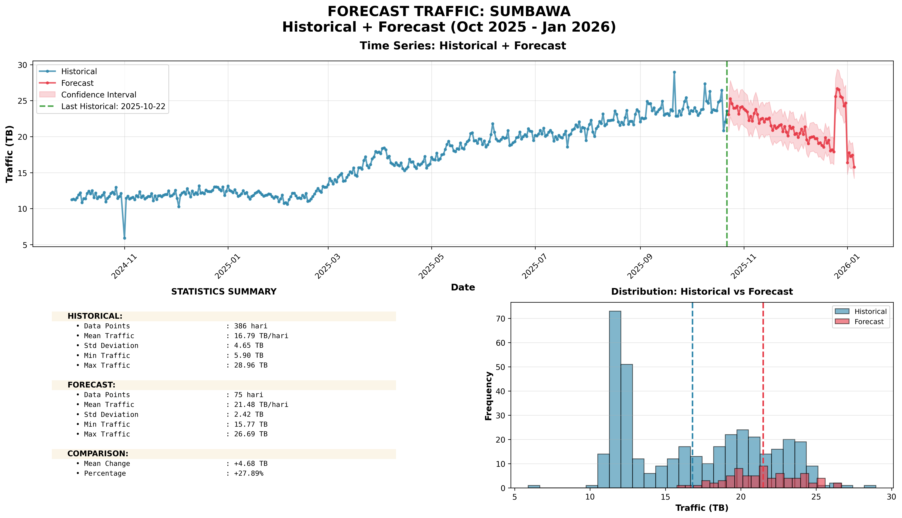
Top 10 Percentage: #9: SUMBAWA (+27.89%)

Slide 33
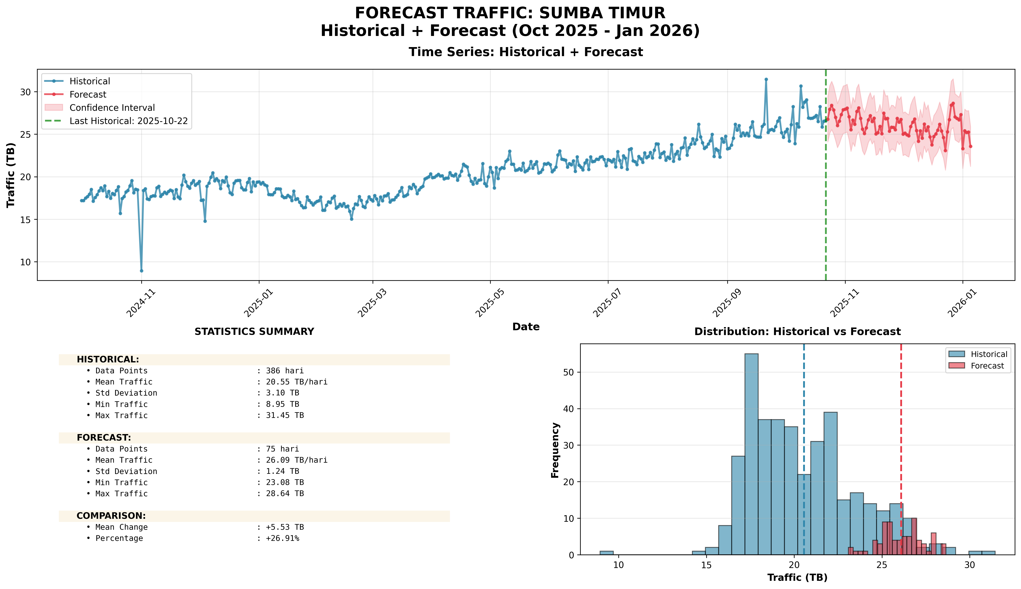
Top 10 Percentage: #10: SUMBA TIMUR (+26.91%)

